Slide 1
Project 2: Unstrained Optimization
Reporter: Faezeh Habibi and Ye Zheng

Slide 2
What We Did
The convergence results and analysis of the given three functions
An Adam implementation to solve the given problems
Faezeh and Ye
Unconstrained Optimization
2

Slide 3

Function 1
The gradient and Hessian are:
The gradient has single zero point and the Hessian is strict positive
Faezeh and Ye
Unconstrained Optimization
3

Slide 4
Function 1
The gradient and Hessian are:
The gradient has single zero point and the Hessian is strict positive
So the global minima is $[0;0;0…]$
Also a quadratic function, Newton method can find the minima in one step
Faezeh and Ye
Unconstrained Optimization
4

Slide 5
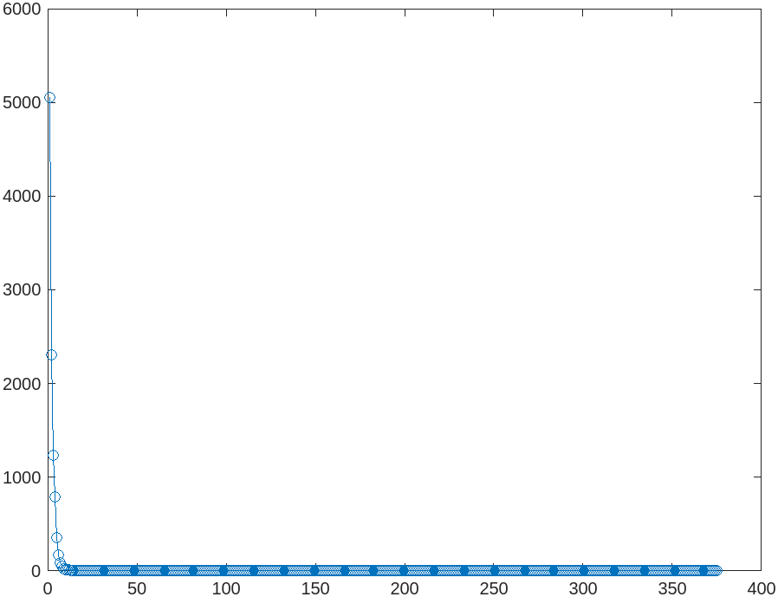
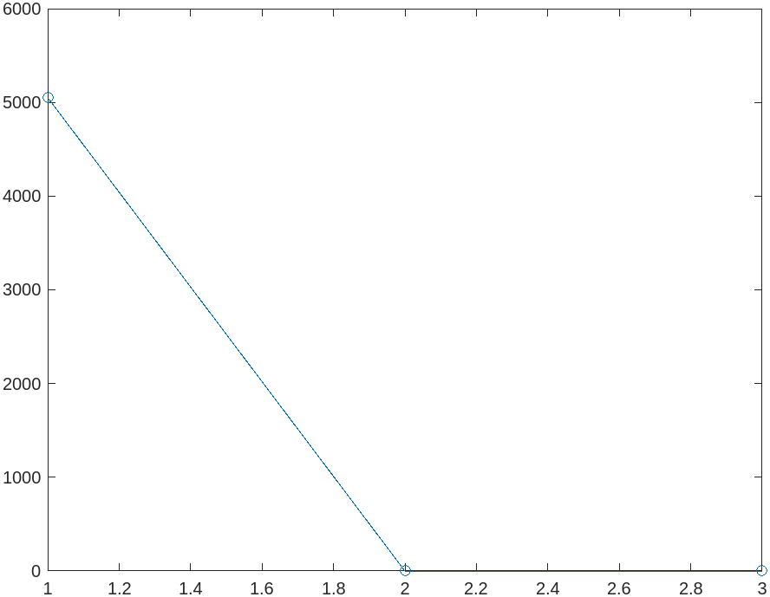
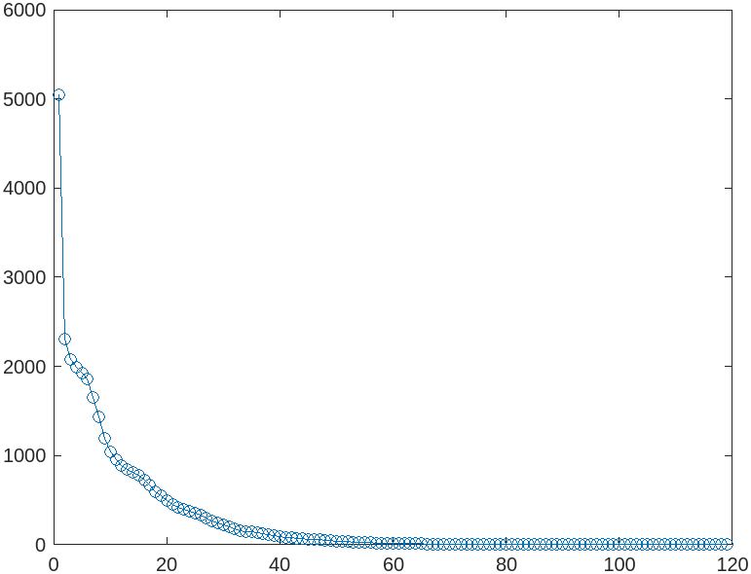
Function 1
Backtracking Line Search: $ρ= 0.9$, Start point: $x = ones(100, 1)$
Method | Gradient Descent | Newton Method | Quasi-Newton
Founded Minimum | 0 | 0 | 0
Iteration Number | 373 | 1 | 117
Gradient Descent
Newton Method
Quasi-Newton
Faezeh and Ye
Unconstrained Optimization
5

Slide 6
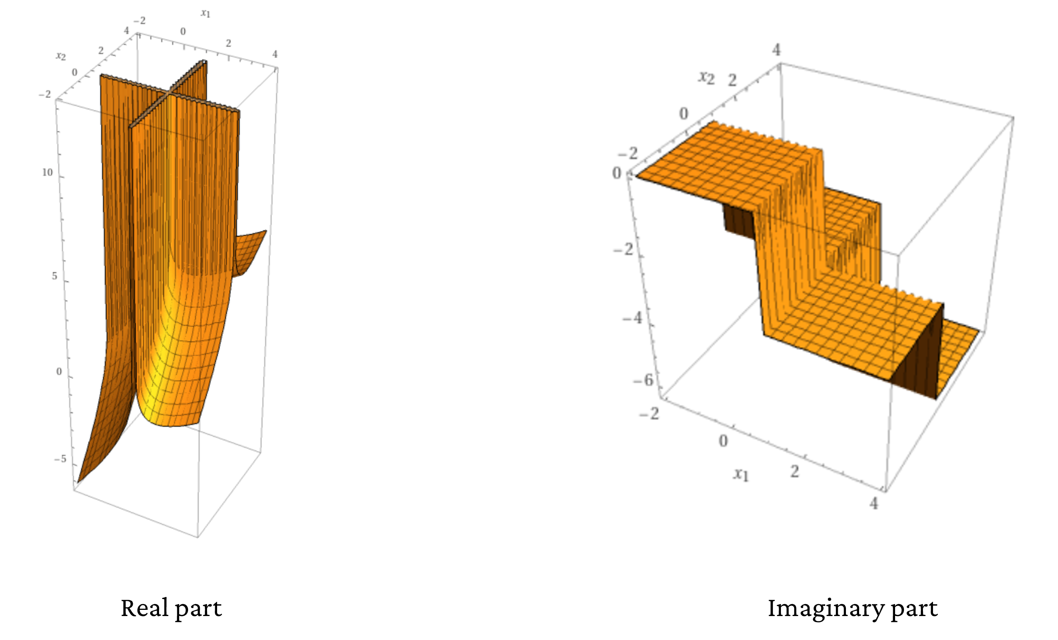
Function 2
If we fix $n=2,c=\left[1 ; 1\right],A=\left[1, 1;1,1\right],b=\left[1 ; 1\right],$ then it is
$$f=x_{1}+x_{2}−\left(ln\left(1−x_{1}\right)+ln\left(1−x_{2}\right)\right)$$
The plot figure:
Faezeh and Ye
Unconstrained Optimization
6

Slide 7
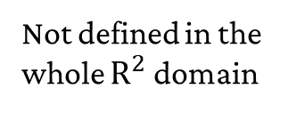
Function 2
If we fix $n=2,c=\left[1 ; 1\right],A=\left[1, 1;1,1\right],b=\left[1 ; 1\right],$ then it is
$$f=x_{1}+x_{2}−\left(ln\left(1−x_{1}\right)+ln\left(1−x_{2}\right)\right)$$
The plot figure:
Not defined in the whole $R^{2}$ domain
Faezeh and Ye
Unconstrained Optimization
7

Slide 8
Function 2
To address this, we
- find zeros(100, 1) is an acceptable start point
- lower the step if $b−Ax<0$, until $log(b−Ax)$ is defined
Faezeh and Ye
Unconstrained Optimization
8

Slide 9
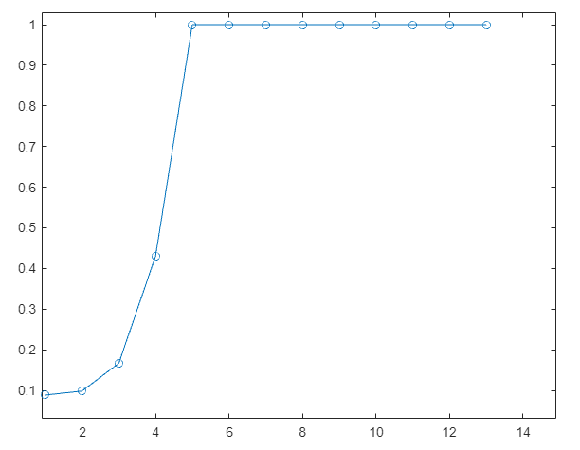
Function 2
To address this, we
- find zeros(100, 1) is an acceptable start point
- lower the step if $b−Ax<0$, until $log(b−Ax)$ is defined
Output parameter $α$ in Newton Method’s 12 iteration:
Very small steps !!
Faezeh and Ye
Unconstrained Optimization
9

Slide 10
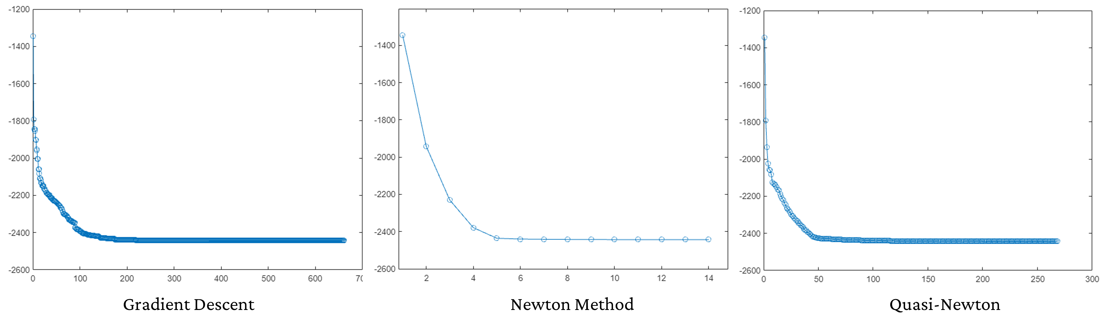
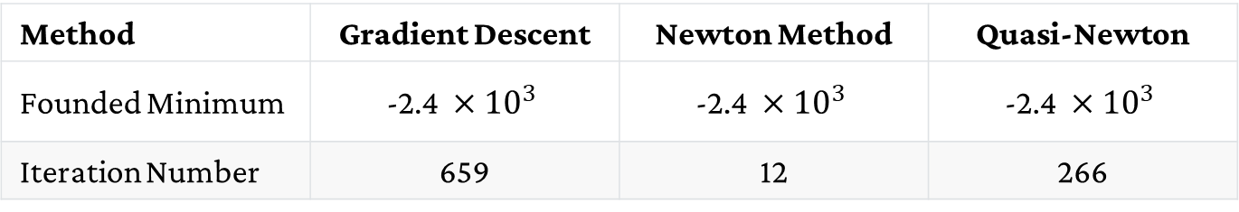
Function 2
Backtracking Line Search: $ρ= 0.9$, Start point: $x =zeros(100, 1)$
Method | Gradient Descent | Newton Method | Quasi-Newton
Founded Minimum | $$\text{−}\text{2.4 }×{10}^{3}$$ | $$\text{−}\text{2.4 }×{10}^{3}$$ | $$\text{−}\text{2.4 }×{10}^{3}$$
Iteration Number | 659 | 12 | 266
Faezeh and Ye
Unconstrained Optimization
10

Slide 11
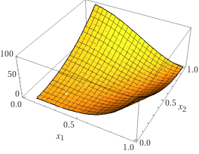
Function 3
Plot figure:
Non-convex function, and Gradient Descent may get stuck
Faezeh and Ye
Unconstrained Optimization
11

Slide 12
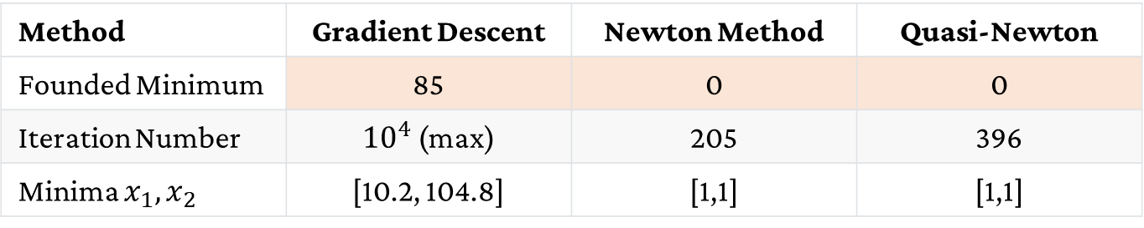
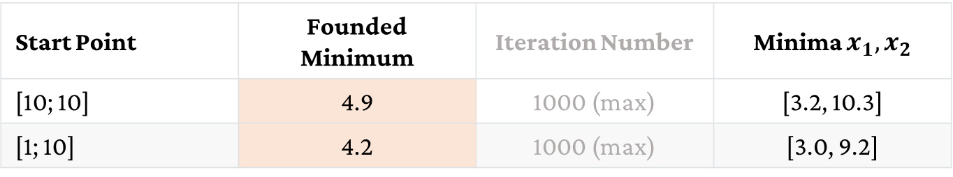
Function 3
Backtracking Line Search: $ρ= 0.9$, Start point: $x =[100;100]$
Method | Gradient Descent | Newton Method | Quasi-Newton
Founded Minimum | 85 | 0 | 0
Iteration Number | ${10}^{4}$ (max) | 205 | 396
Minima $x_{1}, x_{2}$ | [10.2, 104.8] | [1,1] | [1,1]
Other start points for Gradient Descent:
Start Point | Founded Minimum | Iteration Number | Minima $x_{1}, x_{2}$
[10; 10] | 4.9 | 1000 (max) | [3.2, 10.3]
[1; 10] | 4.2 | 1000 (max) | [3.0, 9.2]
Faezeh and Ye
Unconstrained Optimization
12

Slide 13
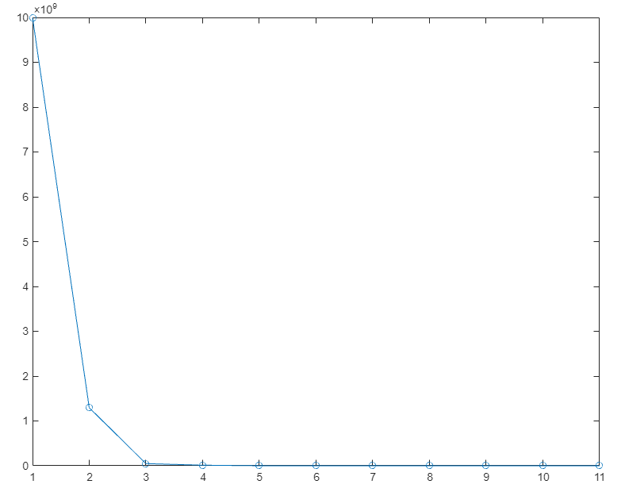
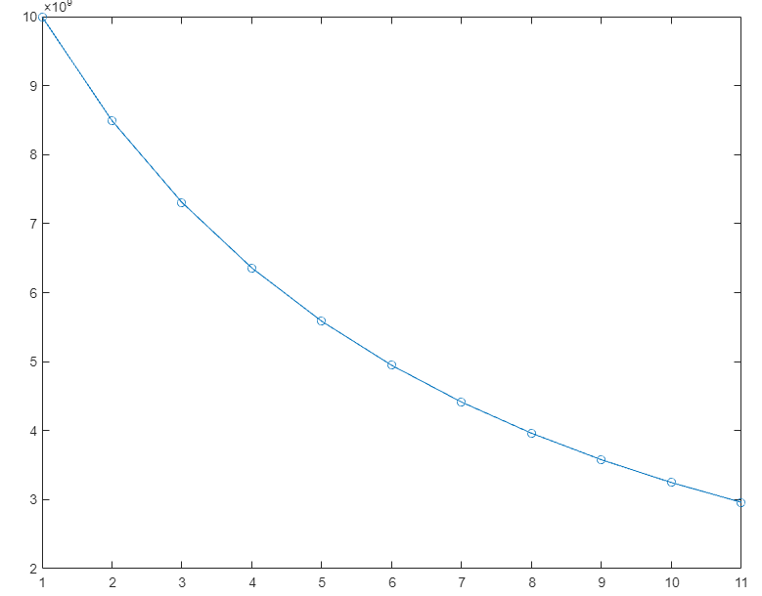
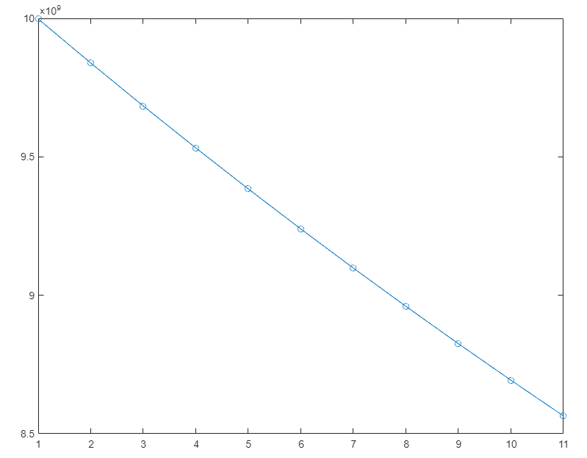
Function 3
Smaller steps in backtracking line search: (c = 0.001 and different ρ)
Generally means slower convergence
ρ=0.1
ρ=0.01
ρ=0.001
Faezeh and Ye
Unconstrained Optimization
13

Slide 14
Adam Optimizer [2014 by Kingma et. al. ]
Adaptive Moment Estimation
- maintains a decreasing (ratio $β$) average of the past gradients
- similar to SGD with Momentum
To escape local minima
Faezeh and Ye
Unconstrained Optimization
14

Slide 15
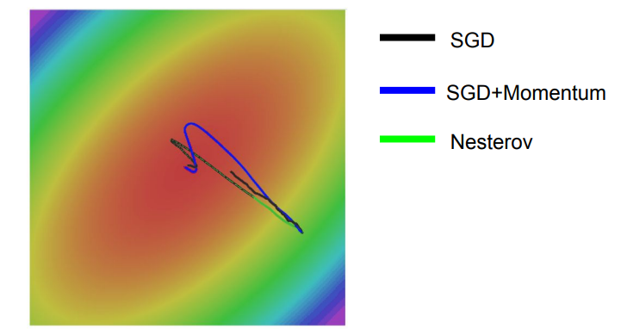
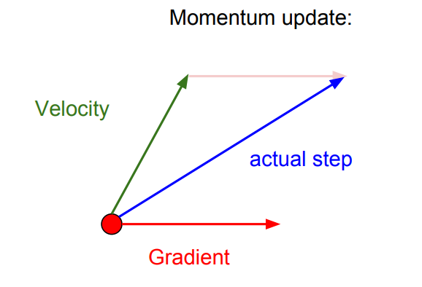
Adam Optimizer [2014 by Kingma et. al. ]
Adaptive Moment Estimation
- maintains a decreasing (ratio $β$) average of the past gradients
- similar to SGD with Momentum
To escape local minima
Faezeh and Ye
Unconstrained Optimization
15

Slide 16
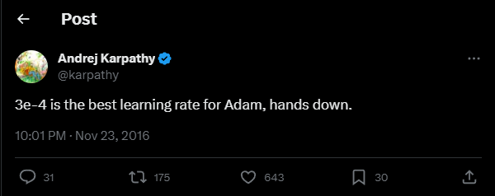
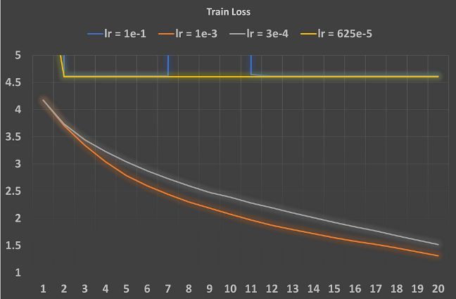
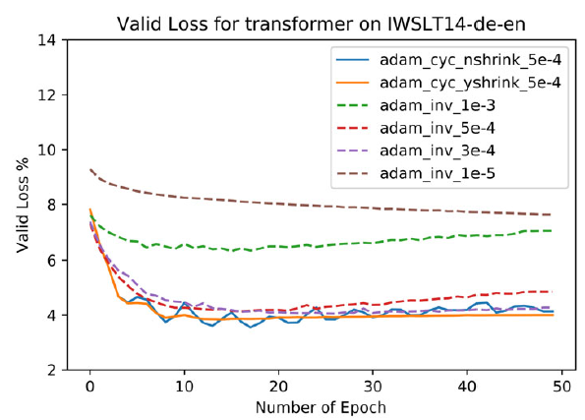
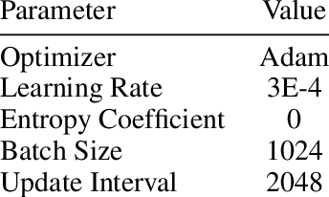
Famous Learning Rate 3e-4
Adam has a famous tricky learning rate 3e-4 (step length)
Faezeh and Ye
Unconstrained Optimization
16

Slide 17
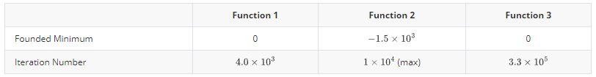
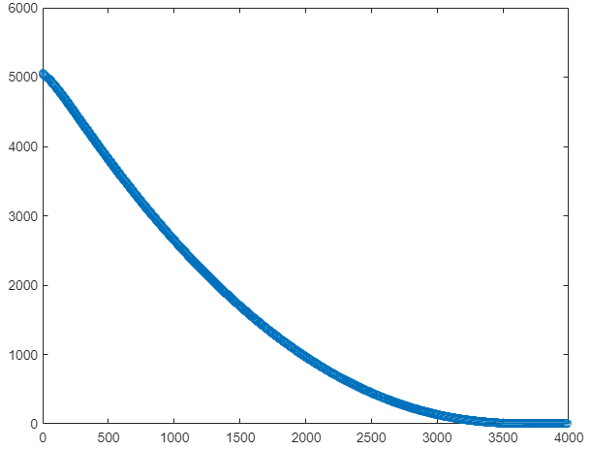
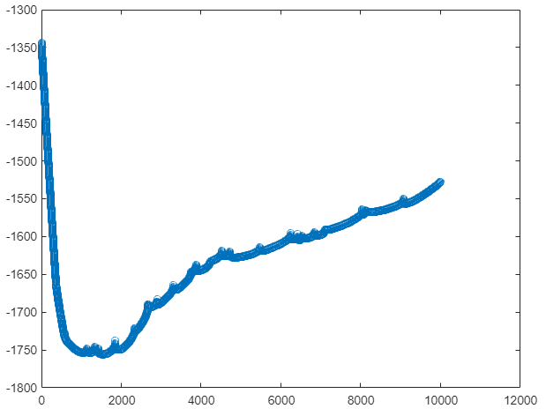
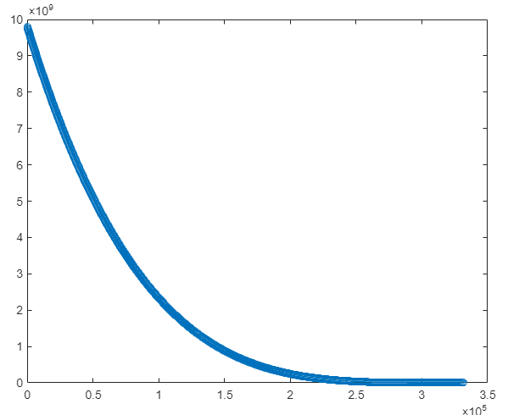
Optimization with Adam 3e-4
with the convergence figures
Function 1
Function 2
Function 3
Faezeh and Ye
Unconstrained Optimization
17

Slide 18
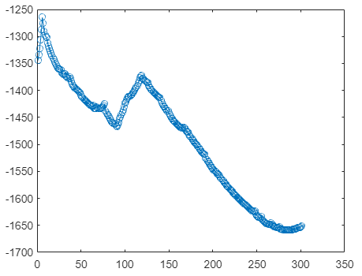
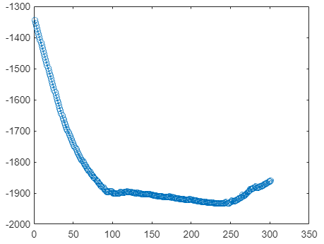
Optimization with Adam 0.1 / 0.01
Step length 0.1 / 0.01 for function 2
Learning rate 0.1
Learning rate 0.01
Faezeh and Ye
Unconstrained Optimization
18

Slide 19
Optimization with Adam 0.1 / 0.01
Step length 0.1 / 0.01 for function 2
Decreasing
step length
Learning rate 0.1
Learning rate 0.01
Still not as good as Backtracking Line Search
Faezeh and Ye
Unconstrained Optimization
19

Slide 20
Optimization with Adam 0.1 / 0.01
Step length 0.1 / 0.01 for function 2
Decreasing
step length
Learning rate 0.1
Learning rate 0.01
The restricted definition domain of function 2 seems hard for Adam
Faezeh and Ye
Unconstrained Optimization
20

Slide 21
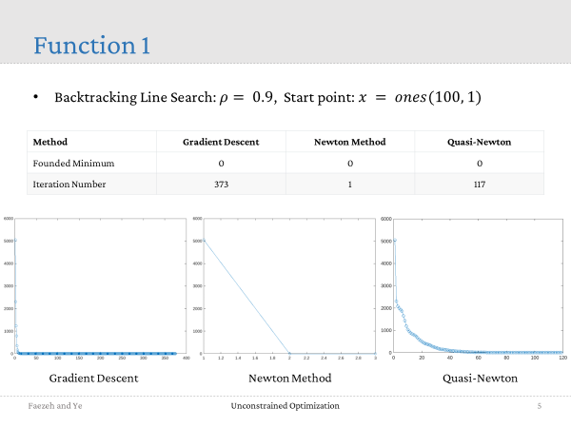
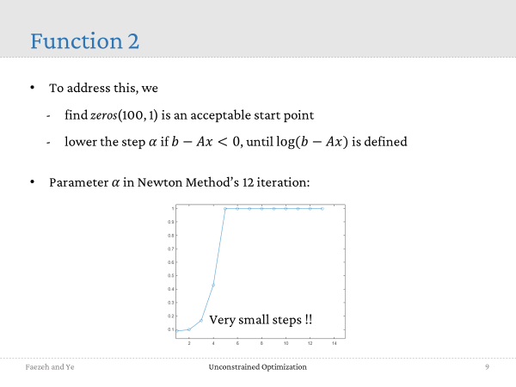
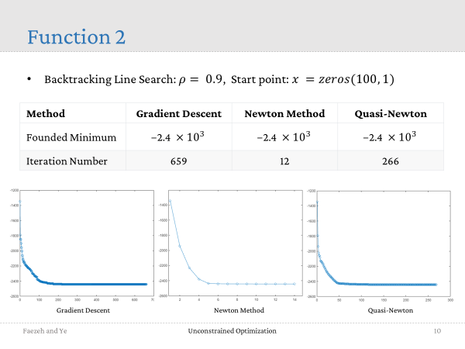
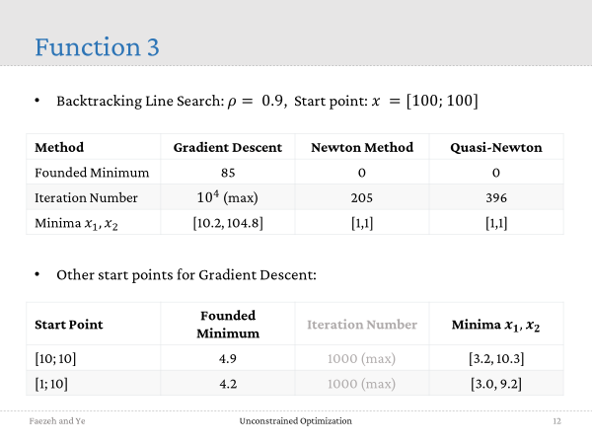
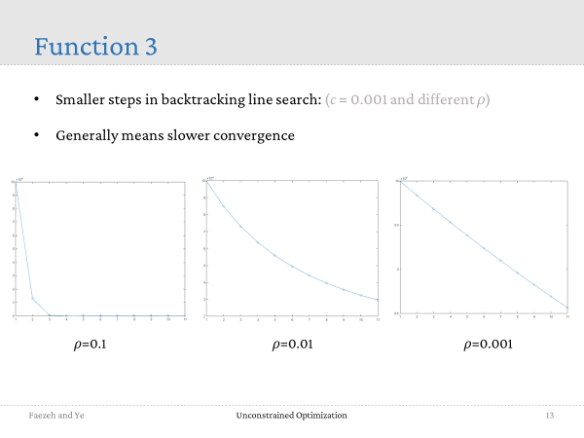
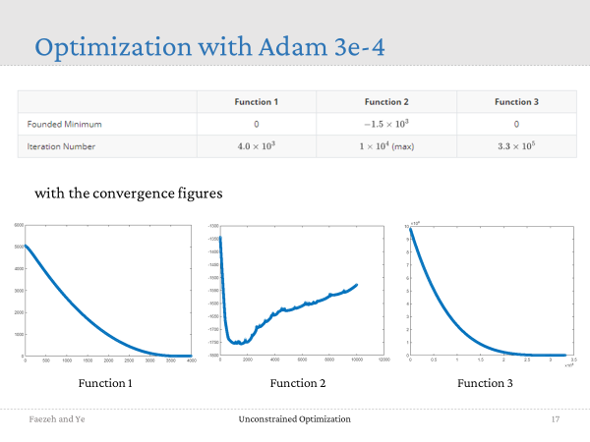

Unconstrained Optimization
Thank you!

